Slide 1
Research and Development Report - AI-Based Tools for photorealistic images
In this PPT im going to show out, how AI tool works for text to image conversion and there is lot of tool in market so im going to show top three best tool.

Slide 2
Castorama bathtub with tap + one Castorama furniture.
Here we go with first image Castorama bathtub with tap + one Castorama furniture.
First tool name - DeepAi
Website link - https://deepai.org/machine-learning-model/fantasy-world-generator
And analysing the website, its a open resource and we have option for
Choose style
Choose shape
Enhance the image size
that can major usefull for image conversion, We can also download the image easily.
But We can not able to change imgae size and resolution

Slide 3
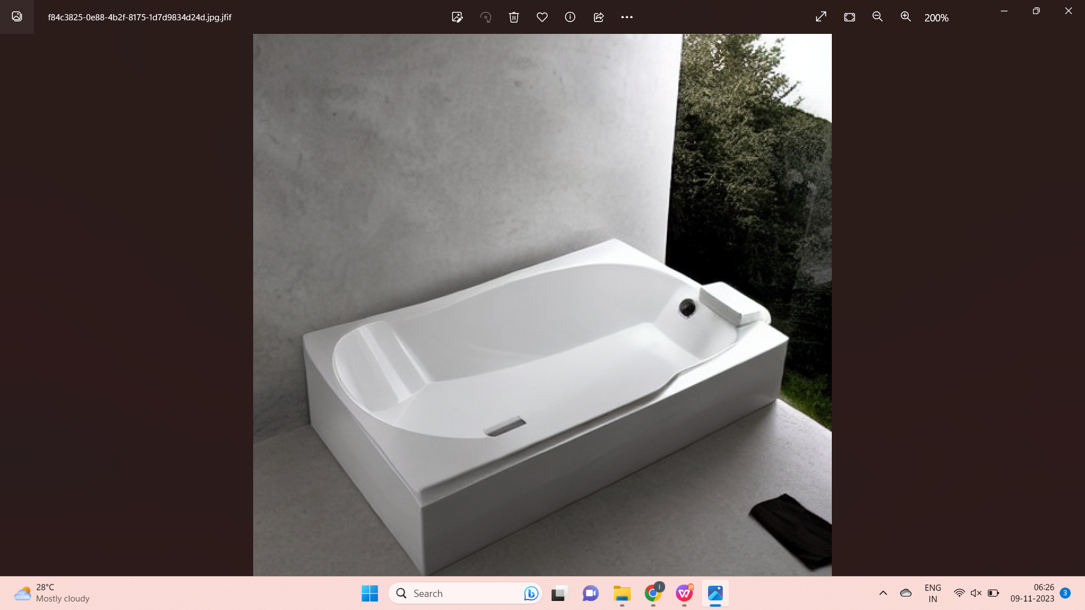
So we have try to find the image with Text “Castorama bathtub with tap + one Castorama furniture.”
And we found this below image
But you can see there is no Tap and furniture, so I did modified the text,

Slide 4
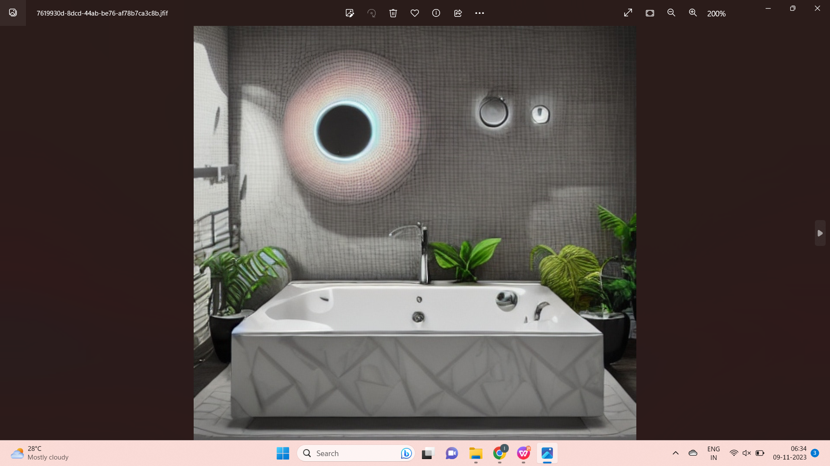
So I search with follow this text “Castorama bathtub with tap and one Castorama furniture.” and we found
For this above imgae still we are not able to see the furniture, and also its feel like not real. as per mutiple modifying the text, we can not able to get Realistic Image. We can try another AI tool

Slide 5
Second tool name - ImagineAI
Website link - https://www.imagine.art/dashboard/tool/from-text
And this site we have multiple option for free user for example.
Aspect Ratio - 1:1 ratio is selected by default. Aspect ratio's determine the dimensions of the generated result. Note: Different ratios may affect the content of the generated images.
Models - Al art models determine what kind of images the Al art generator can produce, model can't have a specific style, aesthetic, or understanding that comes from the art style
Art Styles - Art styles allow users to generate images using a specific style. These are predefined styles made by our team.
Negative Prompt - Negative prompt tells the Al model what you don't want to see in the generated images. When specified, it guides the generation process not to include things in the image according to the given text....etc
We can see 5 image on same time so it can very usefull for this tool. and also we have image full view mode, download, upscale & variate.

Slide 6
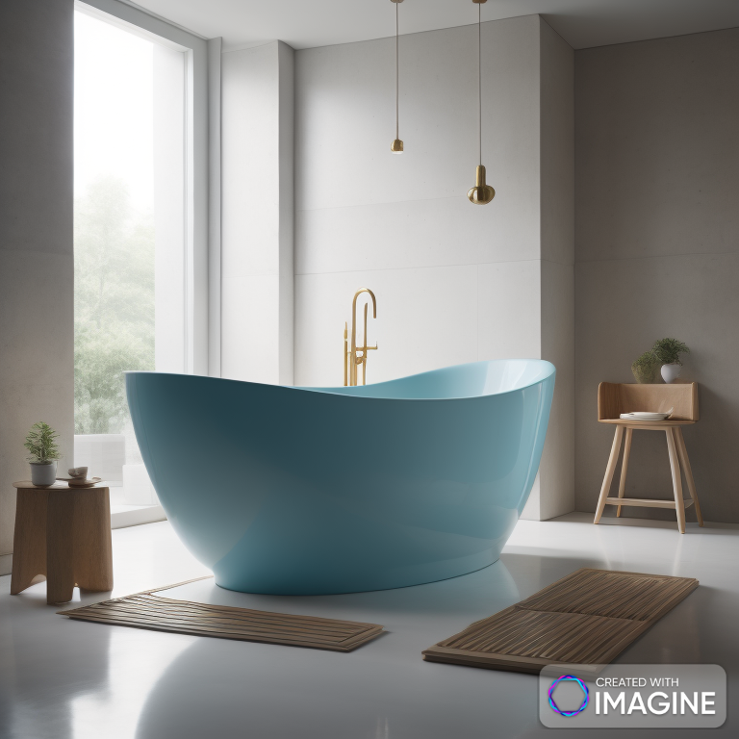
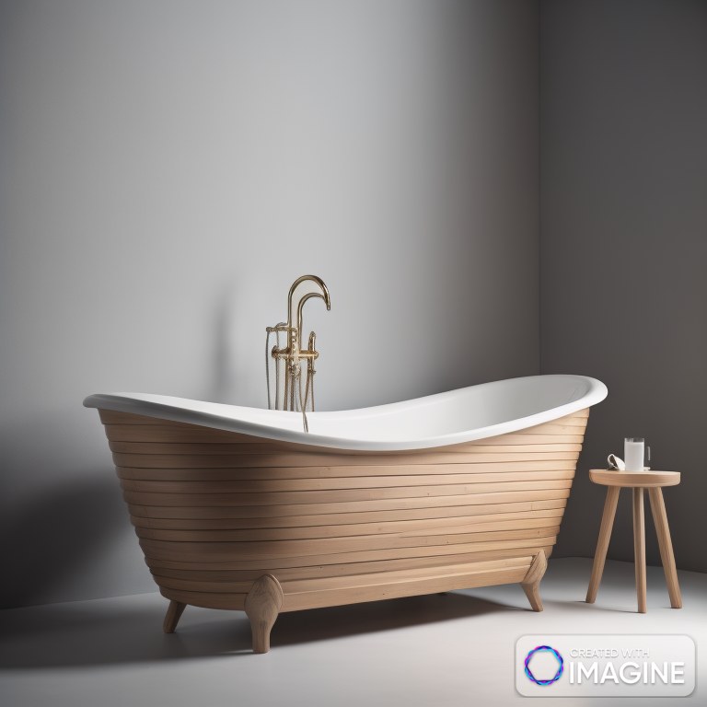
After multiple modifications made to the text, we found a lot of images and finally, I picked the best of Two images.
In this above image we have a bathtub and tap with one furniture, this image is also not even realistic, but this AI tool given our requirement, like Bathtub, Tap, and Furniture, so this AI much better previos tool

Slide 7
Third tool name - AI Image Editor
Website link - https://wepik.com/ai-generate?prompt=Castorama+bathtub+with+tap+%2B+one+Castorama+furniture.&style=noStyle
And this site we have only limited free search, and we have only limited options available, and those are most important like this
Aspect Ratio
Style
Color, lightiung, Framing ....etc
We can see 4 image on same time similar to last AI tool,

Slide 8
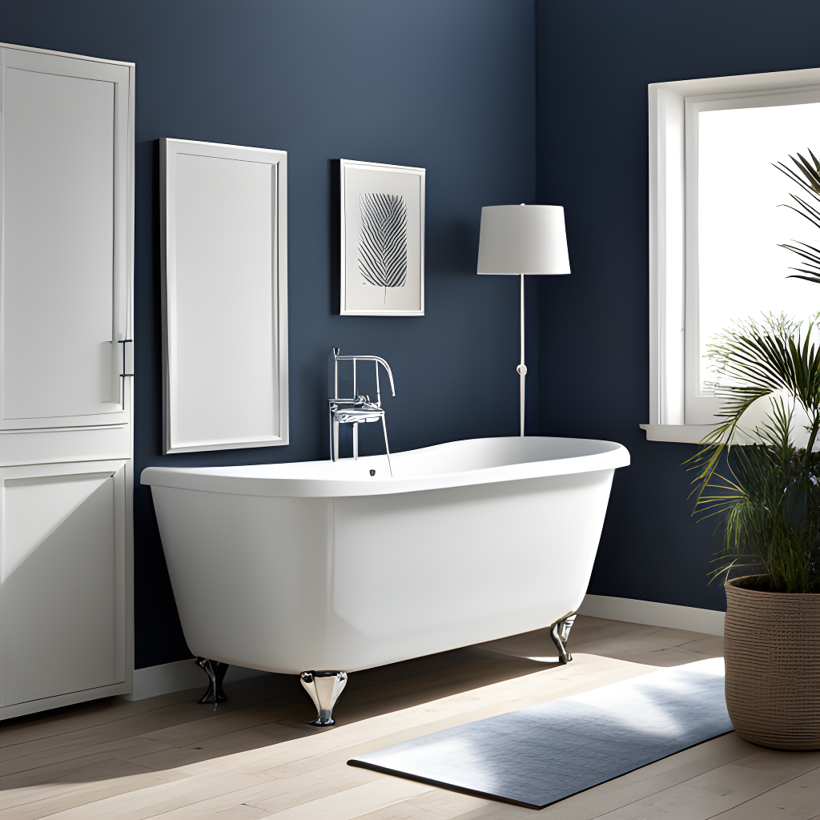
And we found below image
Even this image not even realistic, but this AI tool also given image with Bathtub, Tap, and Furniture, but less option campared with last AI tool

Slide 9
Conculation :
So upon checking above 3 tool, I preffered ImagineAI in this tool we have lot of option there and
compared with other 2 tool. we have similar image output with lot options

Slide 10
Castorama garden shelter + lawnmower + Neva or garden table and chairs.
Here we go with first image Castorama garden shelter + lawnmower + Neva or garden table and chairs.
First tool name - VEED.IO
Website link - https://www.veed.io/tools/ai-image-generator
And analyzing the website, it's an open resource, but we do not have any further option to modify or add special
effects.
But we have some option for viedo editing, like we can able to change the our image to viedo and add music,
text, Elements, Subtitles.. etc

Slide 11
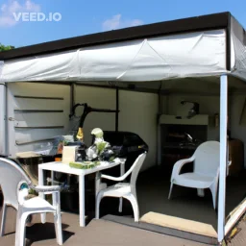
We have try to find the image with Text “Castorama garden shelter + lawnmower + Neva or garden table and chairs.”
And we found this below image
Image is not clear, but almost Realistic, with contain Castorama garden shelter + lawnmower + Neva or garden table and chairs.

Slide 12
Second tool name - Canva
Website link - https://www.canva.com/templates/?query=Castorama-garden-shelter-%2B-lawnmower-%2B-Neva-or-garden-table-and-chairs.
And analyzing the website, it's an open resource, Some of option available, but those are not useful.
since i tried research several times, but we are not getting even 1 proper image, so I not preffered this AI
Tool, even we can not able to download the image, we can only view the image. this Tool not useful

Slide 13
Third tool name - Kapwing AI
Website link - https://www.kapwing.com/64ffd9745e915802a0f339ed/studio/editor
And this website, it's an open resource, I found lot options tool
Image - Crop, Erase, Filter, Enhance
Aspect ratio
Some effects...etc

Slide 14
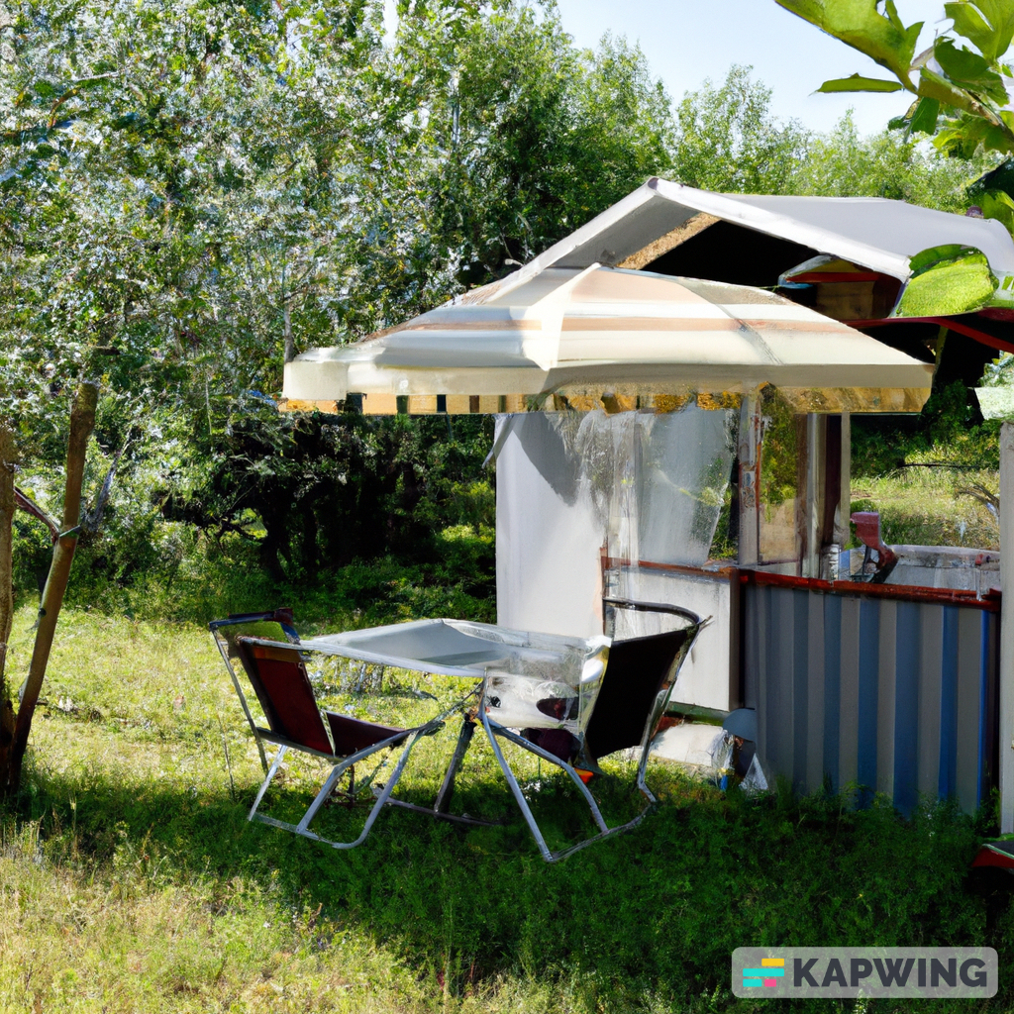
and this AI tool much impresive, cause there is lot of options and image quality,

Slide 15
Conculation :
So upon checking above 3 tool, I preffered Kapwing AI in this tool we have lot of option there and compared with other 2 tool. We got almost expected output.

Slide 16
Bathroom with Castorama shower curtain.
Here we go with first image Bathroom with Castorama shower curtain.
First tool name - craiyonlogo
Website link - https://www.craiyon.com/
And analysing the website, its a open resource and we have limited option for
Art
Drawing
Photo
key option - We got upto 6 image on same time, also similar to realistic

Slide 17
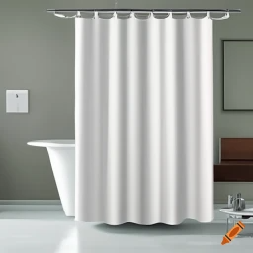
We have try to find the image with Text “Bathroom with Castorama shower curtain.”
And we found this below image
This picture one of the similar to realistic, I found through this AI Tool

Slide 18
Second tool name - Midjourney
Website link - https://docs.midjourney.com/docs/en/command-list
And Features the website, its a open resource
Easy and fun to use
Continuous improvements to the graphics quality of AI-generated pieces for web design
Strong sense of community thanks to existing within Discord
Key limitations - Prompting the tool to upscale images can change the output’s
design slightly and Can be confusing to start with, especially for users new to
Discord

Slide 19
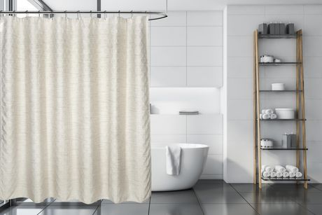
We have try this second tool with text “Bathroom with Castorama shower curtain.”
and found
But you can see the bathtub covers Castorama shower curtain

Slide 20
Third tool name - Jasper Art
Website link - https://www.craiyon.com/
And analysing the website, its a open resource and we have limited option for
AI art is easy to generate on mobile devices
Choose an AI art style
Built-in community of fellow AI art lovers
key option - this AI tool, has mobile app for iOS and Android devices and on
Discord

Slide 21
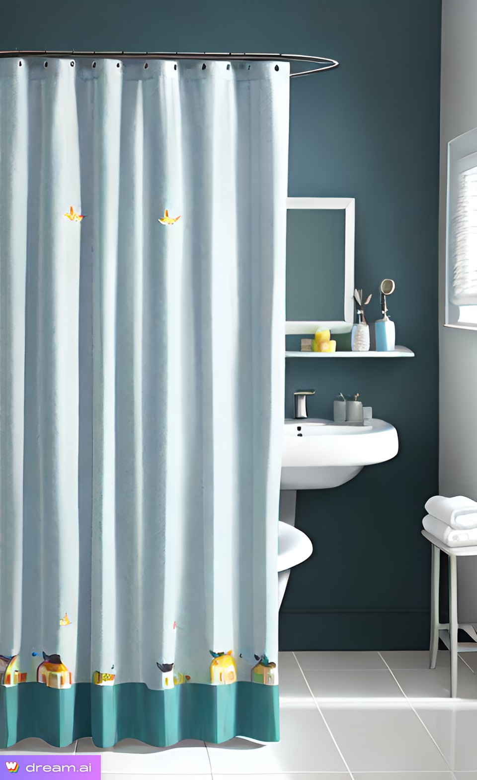
We have try this second tool with text “Bathroom with Castorama shower curtain.”
and found
I belive this i found very realistic image.

Slide 22
Conculation :
So upon checking above 3 tool, I preffered Jasper Art in this tool we have lot of option there and compared with other 2 tool. We got almost expected output.
and This AI tool has.
AI art is easy to generate on mobile devices
Choose an AI art style
Built-in community of fellow AI art lovers

Slide 23
Castorama lawnmower + rack and shovel.
Here we go with first image Castorama lawnmower + rack and shovel.
First tool name - CF Spark Art
Website link - https://www.creativefabrica.com/spark/
And analysing the website, its a open resource and we have limited option for
Approachable for beginners looking to create AI-generated art
Art generator is built into the Creative Fabrica ecosystem
Prompt builder offers a user-friendly way to create detailed prompts
key option - Free credits are available, but the creation speed is slow for the art
generator

Slide 24
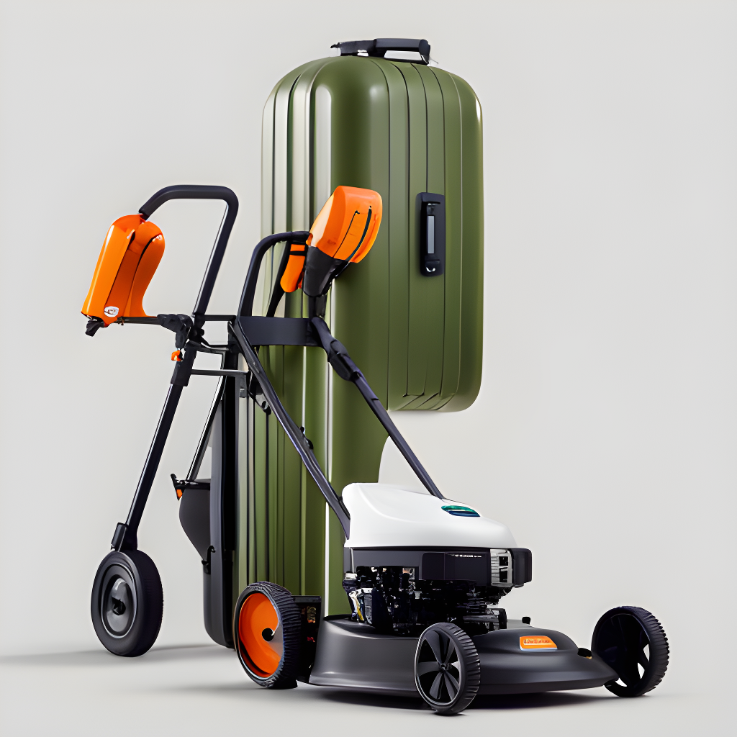
We have try this second tool with text “Castorama lawnmower + rack and shovel.”
and found
we are not getting proper image.

Slide 25
Second tool name - CF Spark Art
Website link - https://www.creativefabrica.com/spark/
And feature of the website, its a open resource
Pixel art generation
GAN images
Line-sketch images,
Filter Images
Customize the quality of images
key option - The time taken to generate an image is more than 5 minutes
sometimes.
Not beginner-friendly

Slide 26
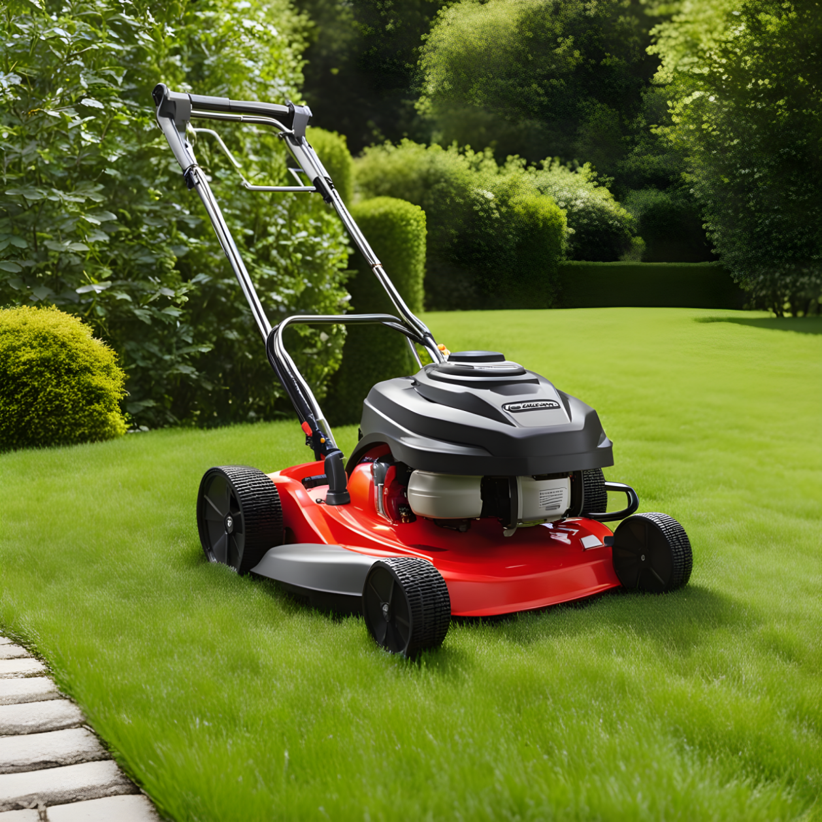
We have try this second tool with text “Castorama lawnmower + rack and shovel.”
and found
we are not getting proper image.

Slide 27
Third tool name - Deep Dream Generator
Website link - https://deepdreamgenerator.com/
And feature of the website, its a open resource
Three significant styles- Deep, Thin, and Deep Dream
Animal illustrations
Landscapes and objects
Multiple painting styles
Image preview available
key option - High-detail image generation takes time to generate,
sometimes around 10 mins.

Slide 28
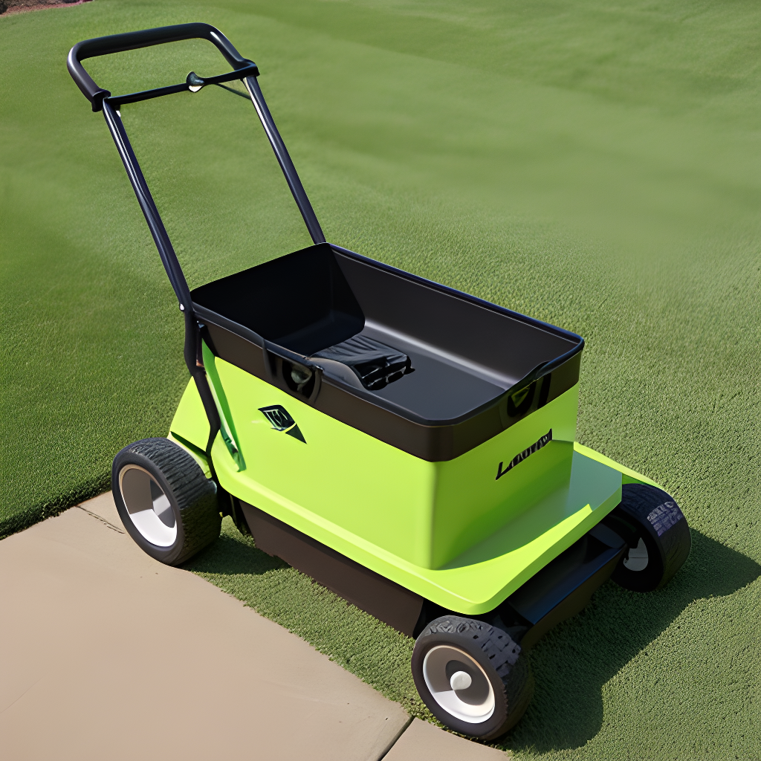
We have try this second tool with text “Castorama lawnmower + rack and shovel.”
and found
we are not getting proper image.

Slide 29
Conculation :
So upon checking above 3 tool, I preffered CF Spark Art in this tool we have lot of option there and compared with other 2 tool. We got almost expected output. and compared with other tool, this one much faster.
I have used different AI tool for all four methodology document. so over all AI tool, some of tool takes much time to generate the image, so over my experiance compare more options and time I preffered ImagineAI and this tool can much faster and easier user friendly.

